Slide 2
introduction
This is a horror film which I intend to create to entertain my audience.
The next slides will show the basic locations I had in mind how ill achieve this and what's the narrative
The order is: narrative, purpose, structure, target audience, location and extras

Slide 3
narrative
A serial killer is on the loose. A man who leaves from a rave is confronted with a series of uncontrollable events
Troupe: don’t walt alone into the darkness

Slide 4
purpose
The purpose of this short film is to entertain the audience and build tension as the film makes progression
A troupe that I think will go well with this is don’t walk alone into the darkness
My main purpose is to really bring out the horror aspect in the short film.

Slide 5
structure
I'm planning on structing like so: stationary pace, through out I'm creating a build up of tension
i might need to make the story more longer as it might be a maximum

Slide 6
Target audience
My target audience is mid age range between 16-34
I achieve the attention of my audience by the realistic effect and realistic storyline as its not a child like ghost story.

Slide 7
location
I want to use the trio underpass near college
A quiet area
Maybe a dead end road
All filming will be held in the night

Slide 8
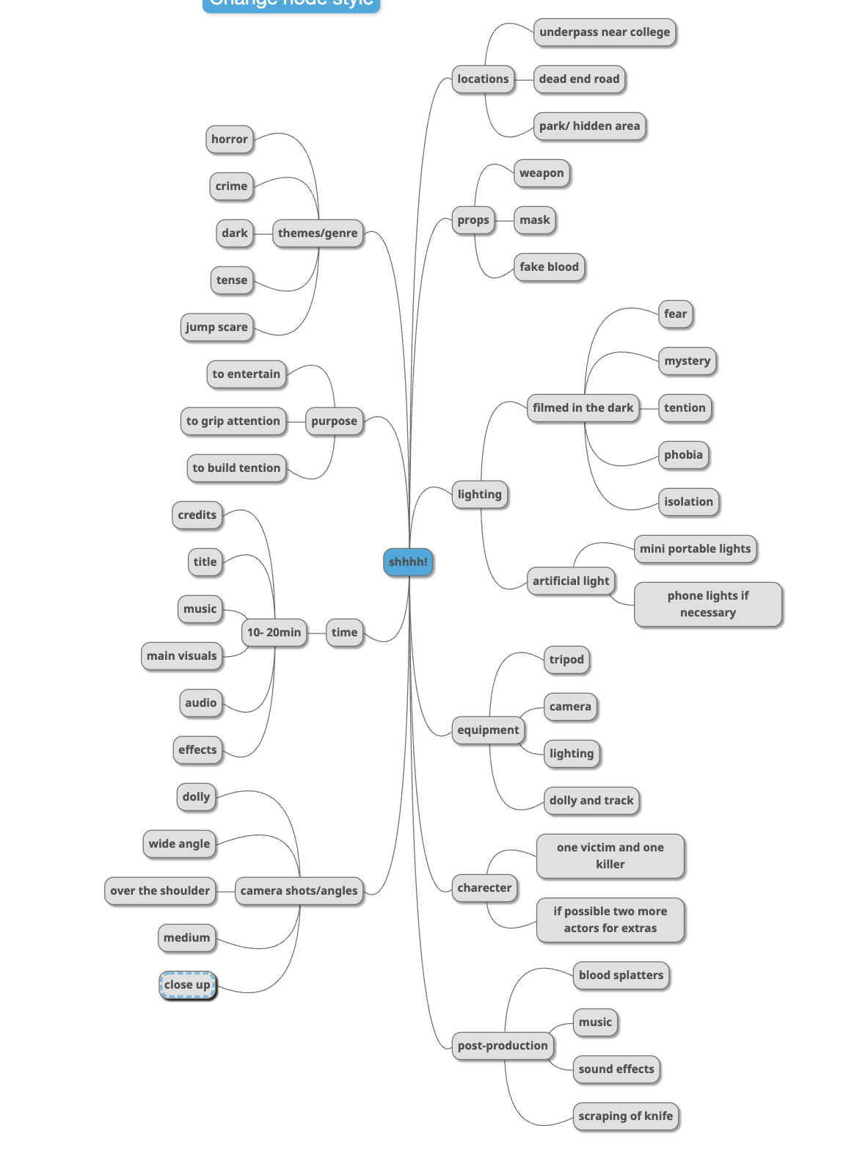
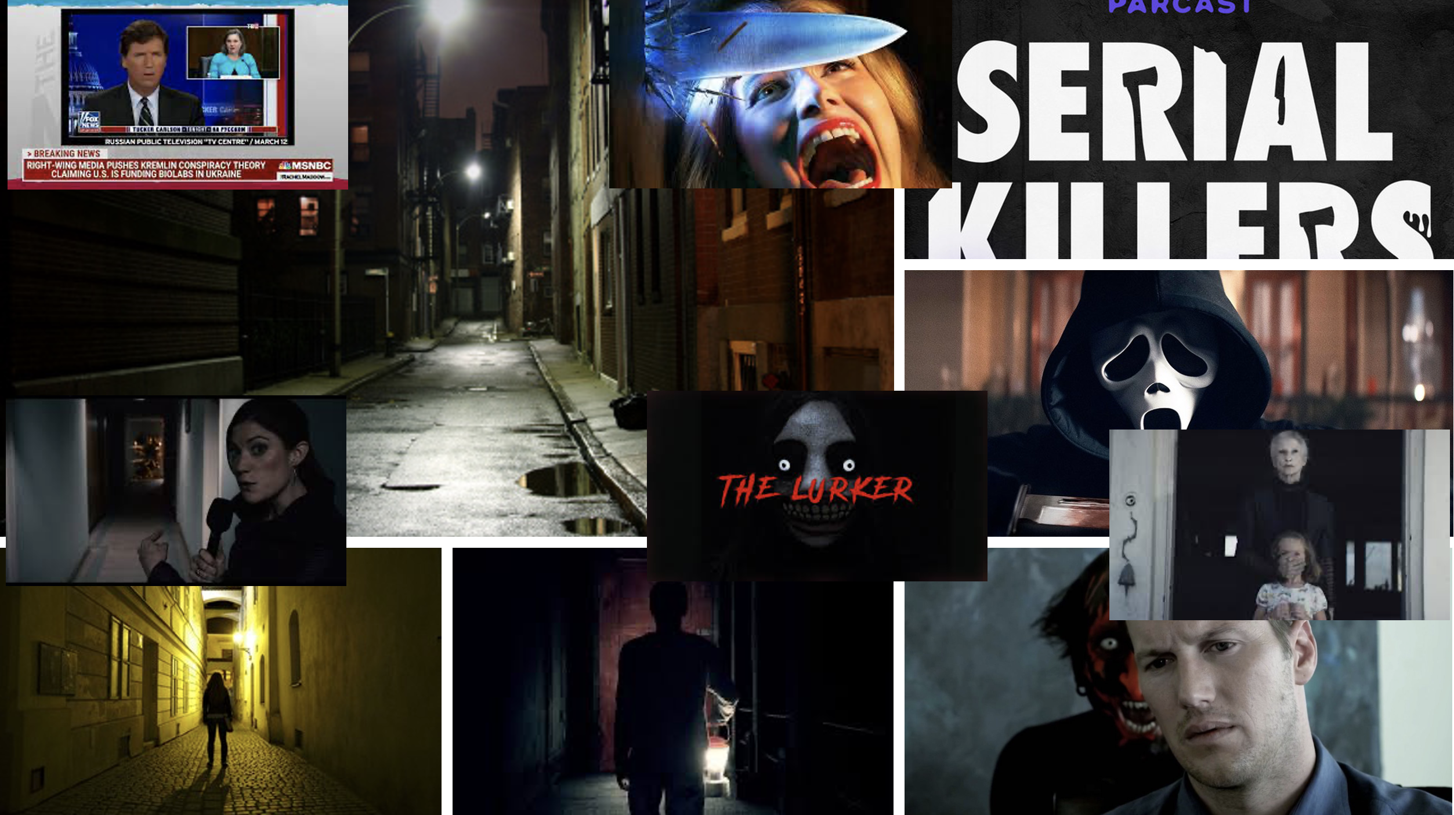
extras
Feedback:
Make the storyline more stronger and think about how long it will take considering the night time filming.

